Slide 1
Exploratory Data Analysis and Preprocessing Data
Session 03-04

Slide 2
Learning Outcome
LO 1: Explain the fundamental of machine learning concept
LO 2: Interpret the distribution of dataset using regression method
LO 3: Experiment classification and clustering algorithm from given dataset

Slide 3
Outline
Exploratory Data Analysis
Preprocessing Data

Slide 4
Exploratory Data Analysis

Slide 5
Exploratory Data Analysis
Exploratory data analysis or “EDA” is a critical first step in analyzing the data from an experiment
the main reasons we use EDA:
detection of mistakes
checking of assumptions
preliminary selection of appropriate models
determining relationships among the explanatory variables, and
assessing the direction and rough size of relationships between explanatory and outcome variables.

Slide 6
Exploratory Data Analysis
Typical data format and the types of EDA
The data from an experiment are generally collected into a rectangular array, , most commonly with one row per experimental subject and one column for each subject identifier, outcome variable, and explanatory variable
People are not very good at looking at a column of numbers or a whole spreadsheet and then determining important characteristics of the data
They find looking at numbers to be tedious, boring, and/or overwhelming.
Exploratory data analysis techniques have been devised as an aid in this situation
Exploratory data analysis is generally cross-classified in two ways:
Each method is either non-graphical or graphical
each method is either univariate or multivariate (usually just bivariate).

Slide 7
Exploratory Data Analysis
Typical data format and the types of EDA
The data from an experiment are generally collected into a rectangular array, , most commonly with one row per experimental subject and one column for each subject identifier, outcome variable, and explanatory variable
People are not very good at looking at a column of numbers or a whole spreadsheet and then determining important characteristics of the data
They find looking at numbers to be tedious, boring, and/or overwhelming.
Exploratory data analysis techniques have been devised as an aid in this situation
Exploratory data analysis is generally cross-classified in two ways:
non-graphical or graphical:
Non-graphical methods generally involve calculation of summary statistics
graphical methods obviously summarize the data in a diagrammatic or pictorial way.
each method is either univariate or multivariate (usually just bivariate).
Univariate methods look at one variable (data column) at a time
multivariate methods look at two or more variables at a time to explore relationships

Slide 8
Exploratory Data Analysis
Univariate non-graphical EDA
The usual goal of univariate non-graphical EDA is to better appreciate the “sample distribution” and also to make some tentative conclusions about what population distribution(s) is/are compatible with the sample distribution.
Outlier detection is also a part of this analysis.
Univariate non-graphical EDA:
Categorical Data: A simple tabulation of the frequency of each category is the best univariate non-graphical EDA for categorical data
Central tendency: (mean, median modus)
Spread: (Variance, Standard Deviation and Interquartile range)
Skewness and Kurtosis

Slide 9
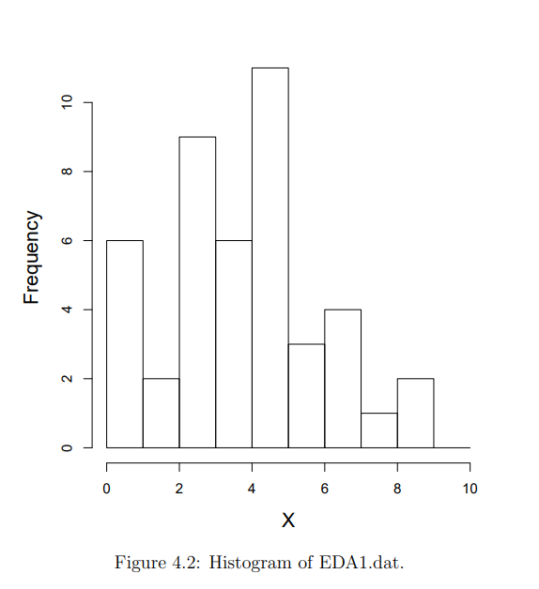
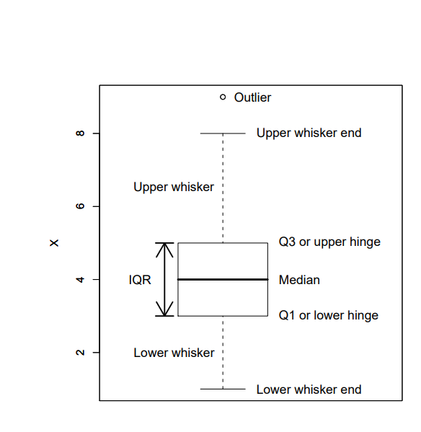
Exploratory Data Analysis
Univariate graphical EDA
Univariate Graphical EDA:
Histograms
Boxplots
Histogram
Boxplot

Slide 10
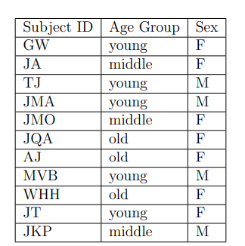
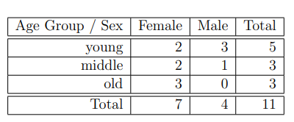
Exploratory Data Analysis
Multivariate non-graphical EDA
Multivariate non-graphical EDA techniques generally show the relationship between two or more variables in the form of either cross-tabulation or correlation.
Multivariate non-graphical EDA
Cross Tabulation: performed by making a two-way table with column headings that match the levels of one variable and row headings that match the levels of the other variable, then filling in the counts of all subjects that share a pair of levels
Correlation: relation between variables
Cross Tabulation

Slide 11
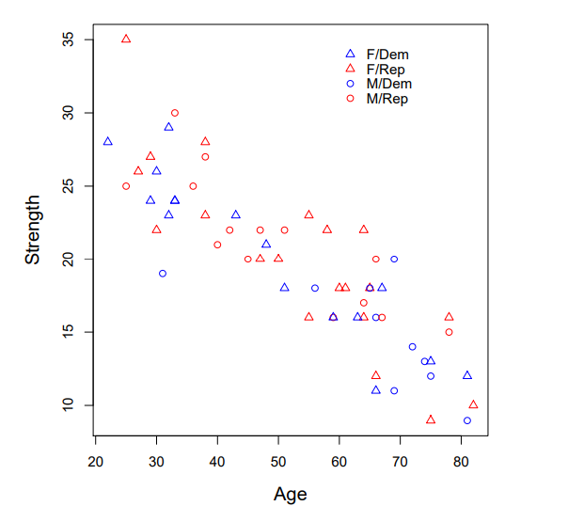
Exploratory Data Analysis
Multivariate graphical EDA
Multivariate Graphical EDA:
Scatterplots
Scatterplot

Slide 12
Data Preprocessing

Slide 13
Data Preprocessing
Data preprocessing is a step in the data mining and data analysis process that takes raw data and transforms it into a format that can be understood and analyzed by computers and machine learning.
Why data preprocessing?
Data in the real world is dirty
incomplete: lacking attribute values, lacking certain attributes of interest, or containing only aggregate data
noisy: containing errors or outliers
inconsistent: containing discrepancies in codes or names
No quality data, no quality mining results!
Quality decisions must be based on quality data.
Data warehouse needs consistent integration of quality data

Slide 14
Data Preprocessing
Data have quality if they satisfy the requirements of the intended use.
Measures for data quality: A multidimensional view
Accuracy: correct or wrong, accurate or not
Completeness: not recorded, unavailable, …
Consistency: some modified but some not, dangling, …
Timeliness: timely update?
Believability: how trustable the data are correct?
Interpretability: how easily the data can be understood?

Slide 15
Data Preprocessing
Major Task in Data Preprocessing:
Data cleaning:
Fill in missing values, smooth noisy data, identify or remove outliers, and resolve inconsistencies
Data integration
Integration of multiple databases, data cubes, or files
Data transformation
Normalization and aggregation
Data Reduction
Obtains reduced representation in volume but produces the same or similar analytical results
Data discretization
Part of data reduction but with particular importance, especially for numerical data

Slide 16
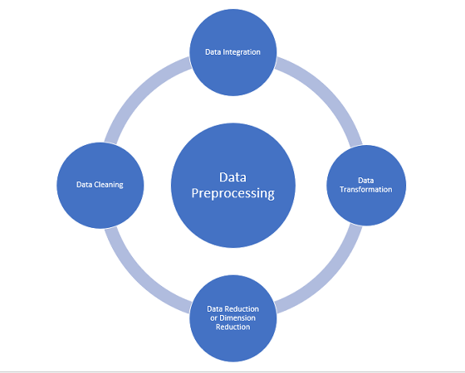
Data Preprocessing

Slide 17
Data Preprocessing
Data Cleaning
Noise:
If users believe the data are dirty, they are unlikely to trust the results of any data mining that has been applied to it.
Dirty data can cause confusion for the mining procedure, resulting in unreliable output
Data Cleaning Problem:
incomplete: lacking attribute values, lacking certain attributes of interest, or containing only aggregate data
e.g: Occupation = “ ” (missing data)
noisy: containing noise, errors, or outliers
e.g: Salary = “−10” (an error)
inconsistent: containing discrepancies in codes or names, e.g.,
e.g: Was rating “1, 2, 3”, now rating “A, B, C”
intentional: (e.g., disguised missing data)

Slide 18
Data Preprocessing
Data Cleaning
Incomplete Data:
Missing data may be due to
equipment malfunction
inconsistent with other recorded data and thus deleted
data not entered due to misunderstanding
certain data may not be considered important at the time of entry
not register history or changes of the data
How to handle missing data:
Ignore or remove the missing tuple
Fill in the missing value manually
Fill in it automatically with
a global constant
the attribute mean
the attribute mean for all samples belonging to the same class

Slide 19
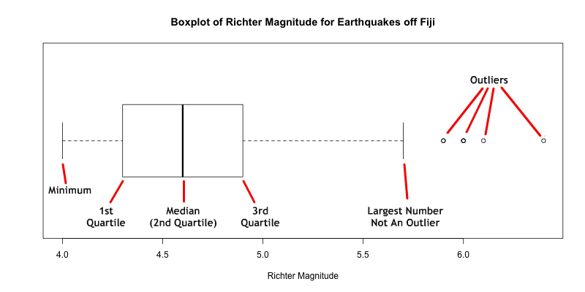
Data Preprocessing
Data Cleaning
Noisy Data:
random error or variance in a measured variable
Outliers may represent noise.
To Find outlier in our dataset we can used Box-Plot

Slide 20
Data Preprocessing
Data Cleaning
How handle the noise?
Data Smoothing
Removing the outlier based on the Box Plot

Slide 21
Data Preprocessing
Data Integration
Data integration:
Combines data from multiple sources into a coherent source.
Careful integration can help reduce and avoid redundancies and inconsistencies.
Schema integration:
Integrate metadata from different sources
e.g., A.cust-id, B.cust-#
Entity identification problem:
Identify real world entities from multiple data sources,
e.g., Bill Clinton = William Clinton
Detecting and resolving data value conflicts
For the same real world entity, attribute values from different sources are different
Possible reasons: different representations, different scales, e.g., metric vs. British units

Slide 22
Data Preprocessing
Data Transformation and Discretization
In data transformation, the data are transformed or consolidated into forms appropriate for mining.
In data transformation, a function that maps the entire set of values of a given attribute to a new set of replacement values such that each old value can be identified with one of the new values.
Some of data transformation strategies:
Normalization: The attribute data are scaled so as to fall within a small specified range.
Discretization: A numeric attribute is replaced by a categorical attribute.

Slide 23
Data Preprocessing
Data Transformation and Discretization
Data Normalization:
An attribute is normalized by scaling its values so that they fall within a small specified range.
A larger range of an attribute gives a greater effect (weight) to that attribute.
This means that an attribute with a larger range can have greater weight at data minining tasks than an attribute with a smaller range.
Normalizing the data attempts to give all attributes an equal weight.
Normalization is particularly useful for classification algorithms involving neural networks or distance measurements such as nearest-neighbor classification and clustering.
Some Normalization Methods:
Min-max normalization
Z-score normalization
Normalization by decimal scaling

Slide 24
Data Preprocessing
Data Transformation and Discretization
Data Discretization:
Some data mining algorithms require that data be in the form of categorical attributes.
In discretization:
The range of a continuous attribute is divided into intervals.
Then, interval labels can be used to replace actual data values to obtain a categorical attribute.
Simple Discretization Example: income attribute is discretized into a categorical attribute.
Target categories (low, medium, high).
Calculate average income: AVG.
if income> 2* AVG, new_income_value = “high”.
If income < 0.5* AVG, new_income_value = “low”.
Otherwise, new_income_value = “medium”.

Slide 25
Data Preprocessing
Data Reduction
Data reduction: Obtain a reduced representation of the data set that is much smaller in volume but yet produces the same (or almost the same) analytical results
Why data reduction? — A database/data warehouse may store terabytes of data. Complex data analysis may take a very long time to run on the complete data set.
Data reduction strategies:
Dimensionality reduction/ Feature Selection: e.g., remove unimportant attributes
Correlation based feature selection
PCA (it will be explained later in Session 21-22)

Slide 26
Data Preprocessing
Data Reduction
Correlation based Feature Selection (CFS) :
Correlation-based Feature Selection (CFS) is a feature selection technique that selects subsets of features that are highly correlated with the target variable but have low correlation with each other.
The idea behind CFS is to identify a subset of features that can provide the maximum amount of information about the target variable while minimizing redundancy among the features.
The CFS algorithm works by first calculating the correlation between each feature and the target variable. Then, it computes the correlation between each pair of features. Next, it selects the subset of features that has the highest correlation with the target variable and the lowest correlation with each other.

Slide 27
Exercise

Slide 28
Exercise
You are a data scientist tasked with analyzing the Titanic dataset. The ultimate goal of your analysis is to build a model that can predict which passengers survived the Titanic disaster (https://www.kaggle.com/competitions/titanic). To achieve this, you need to undertake two critical stages: Exploratory Data Analysis (EDA) and Data Preprocessing.
Exploratory Data Analysis (EDA)
Conduct a descriptive analysis to understand the features within the dataset, such as 'age', 'sex', 'pclass', among others. Identify the distribution of data and any patterns that may exist.
Visualize the data to uncover relationships between features using diagrams such as histograms, box plots, and scatter plots.
Find and explain any interesting insights from the data that might be useful for predicting passenger survival.
Data Preprocessing
Clean the data by handling missing values. Determine your strategy for filling in missing data or removing rows/columns if necessary.
Perform encoding on categorical features and explain why you chose a specific type of encoding.
Normalize or standardize numerical features that you deem necessary, and explain the reason for your choice of method.

Slide 29
References

Slide 30
References
https://www.stat.cmu.edu/~hseltman/309/Book/chapter4.pdf
https://www3.cs.stonybrook.edu/~cse634/lecture_notes/07preprocessing.pdf
https://www.iitr.ac.in/media/facspace/patelfec/16Bit/slides/Lecture-2-Data-Preprocessing-Part-1.pdf
https://web.cs.hacettepe.edu.tr/~ilyas/Courses/VBM684/lec03-DataPreprocessing.pdf
https://medium.com/@sariq16/correlation-based-feature-selection-in-a-data-science-project-3ca08d2af5c6

